Slide 1
Generating annotated training and testing data

Slide 2
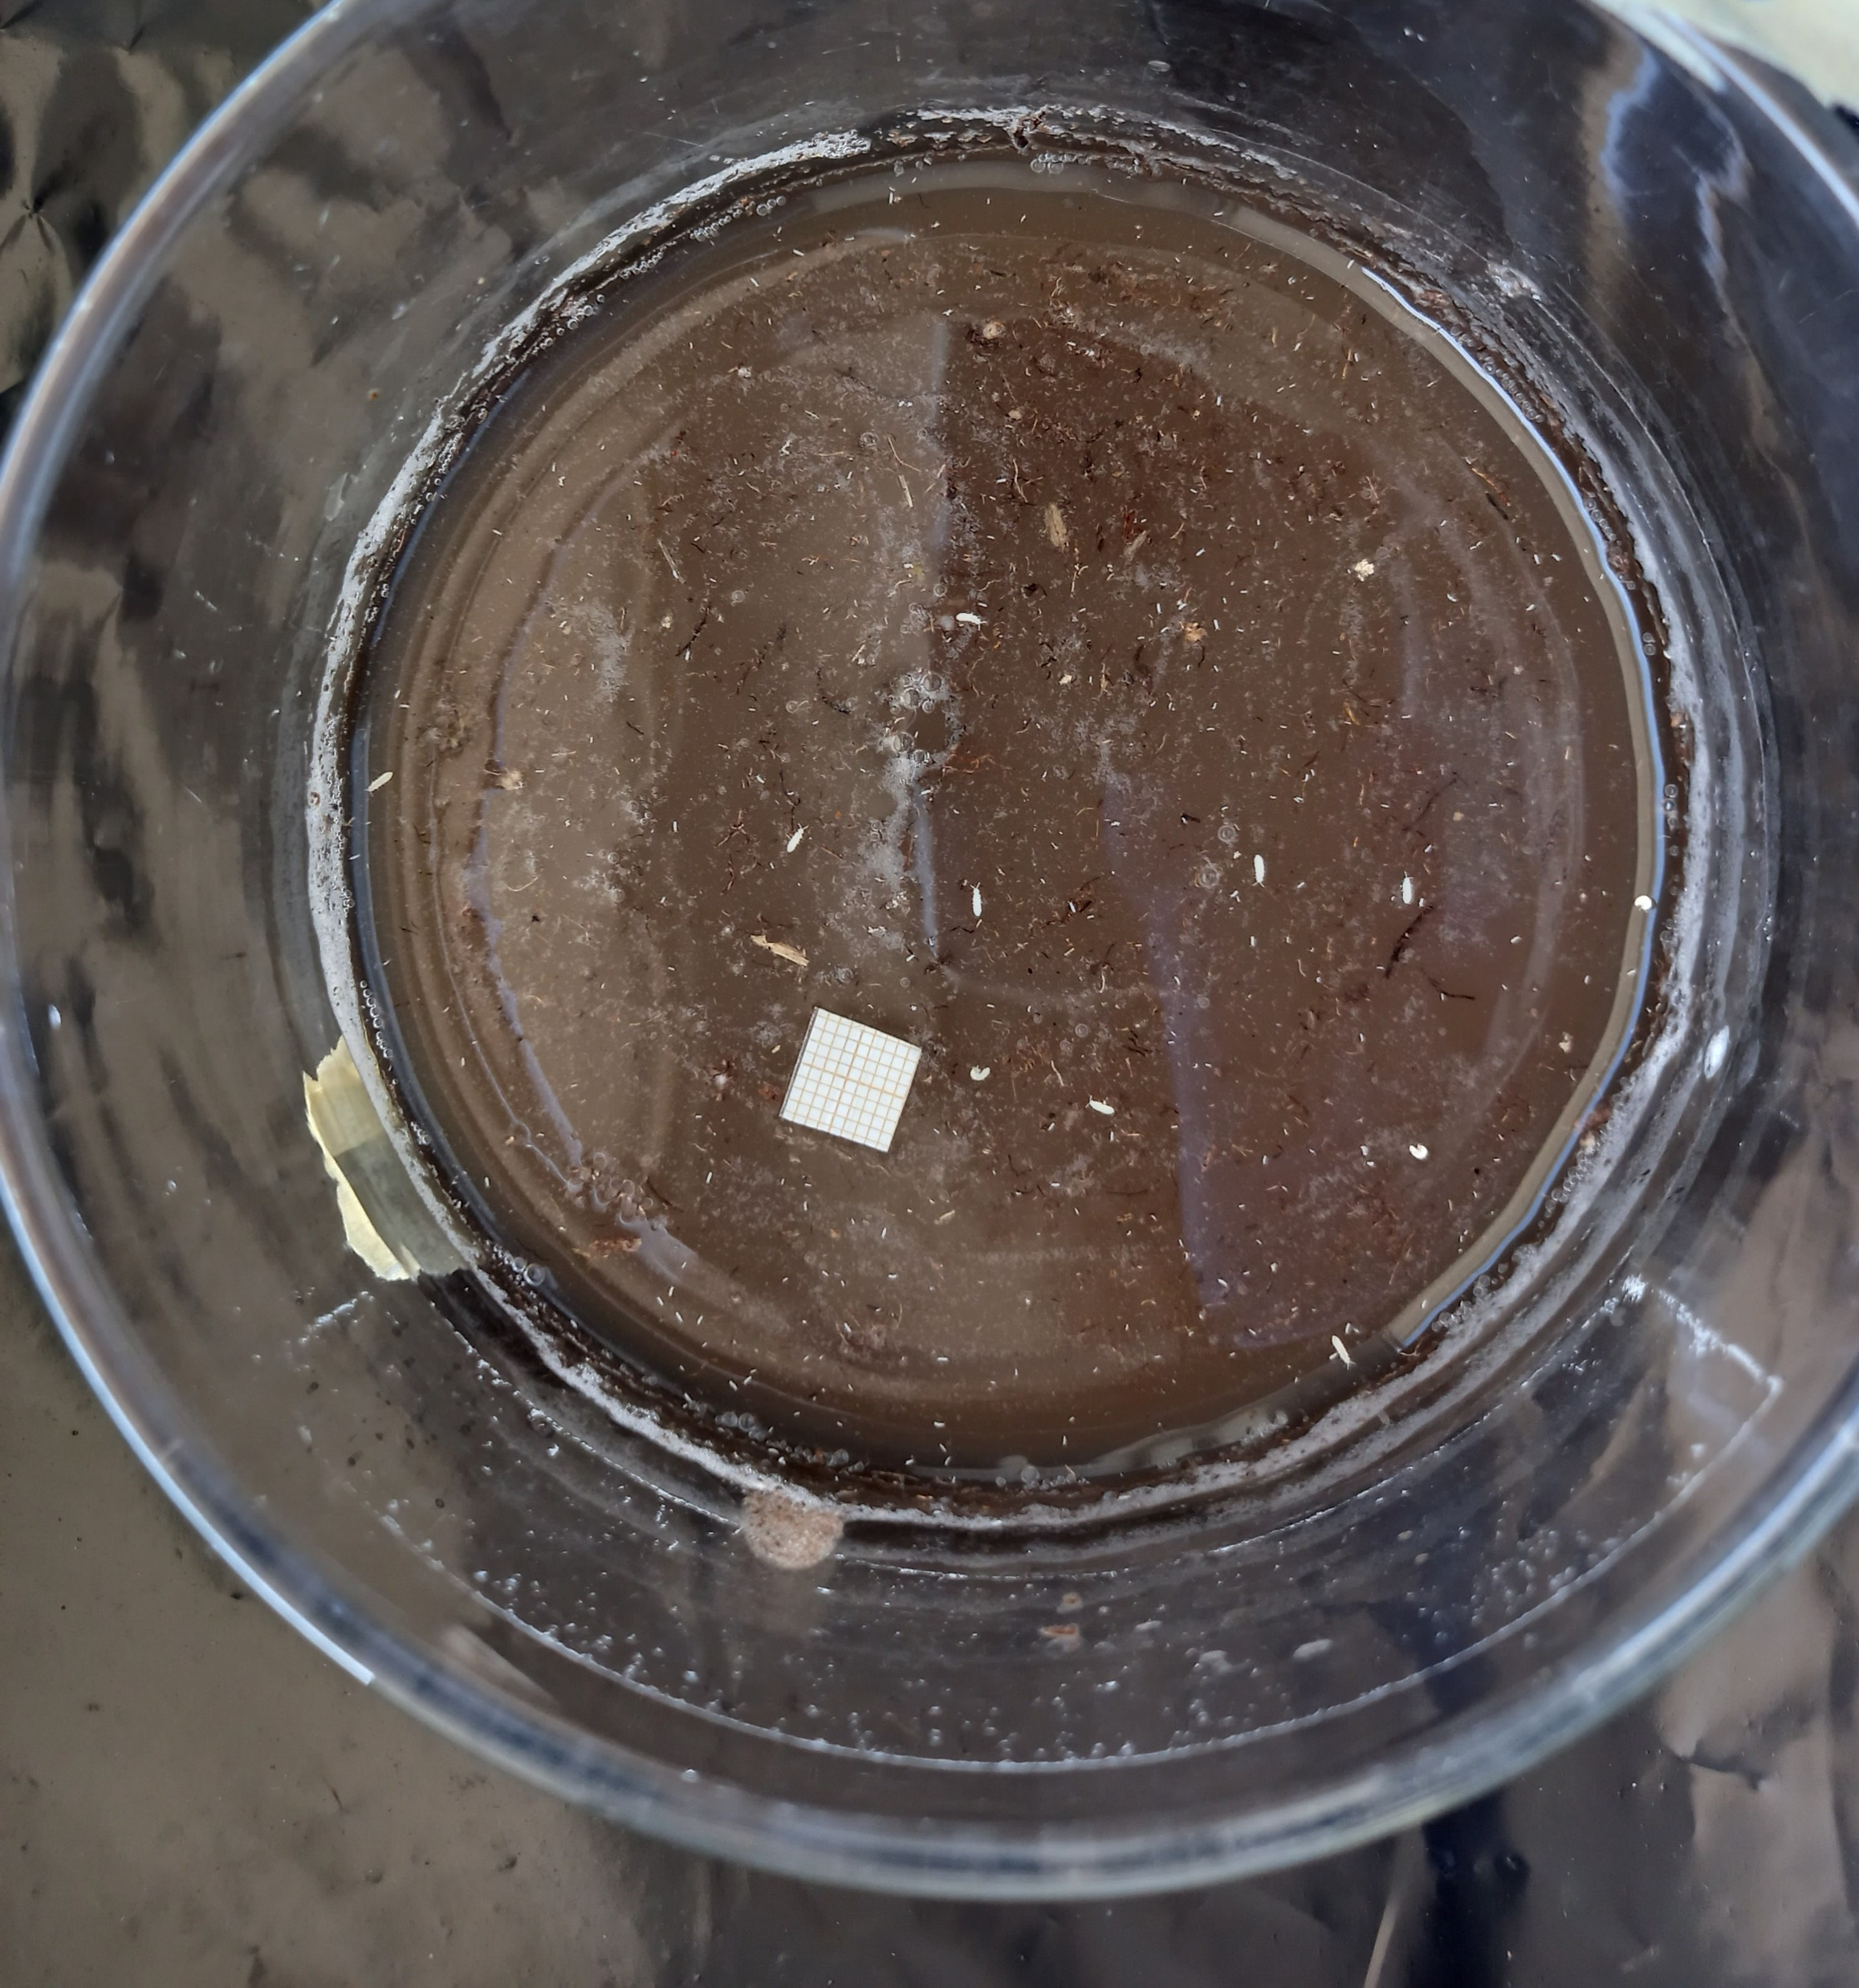

Slide 3
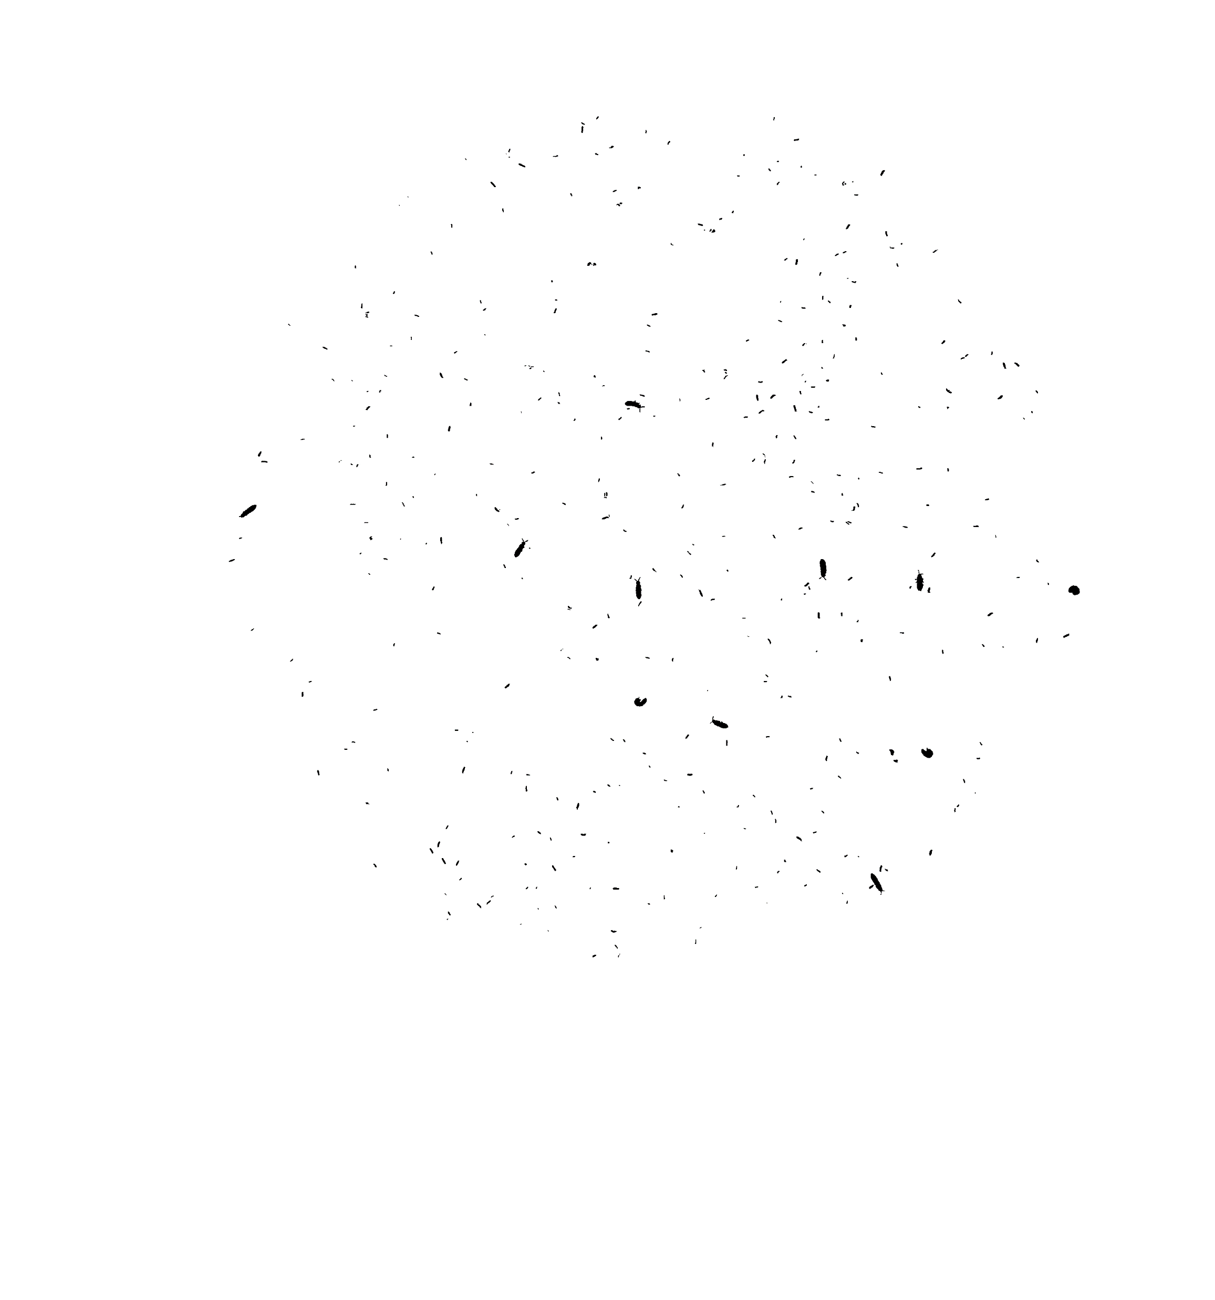

Slide 4
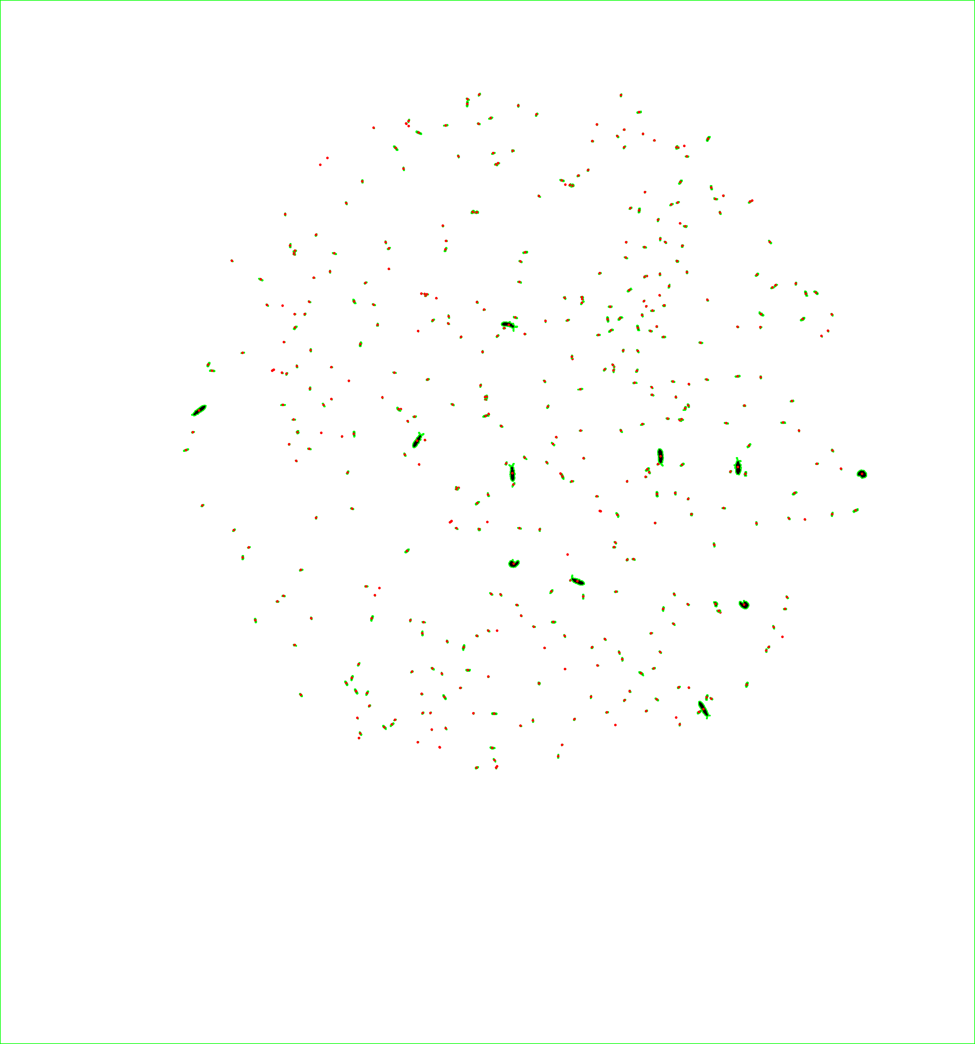

Slide 6
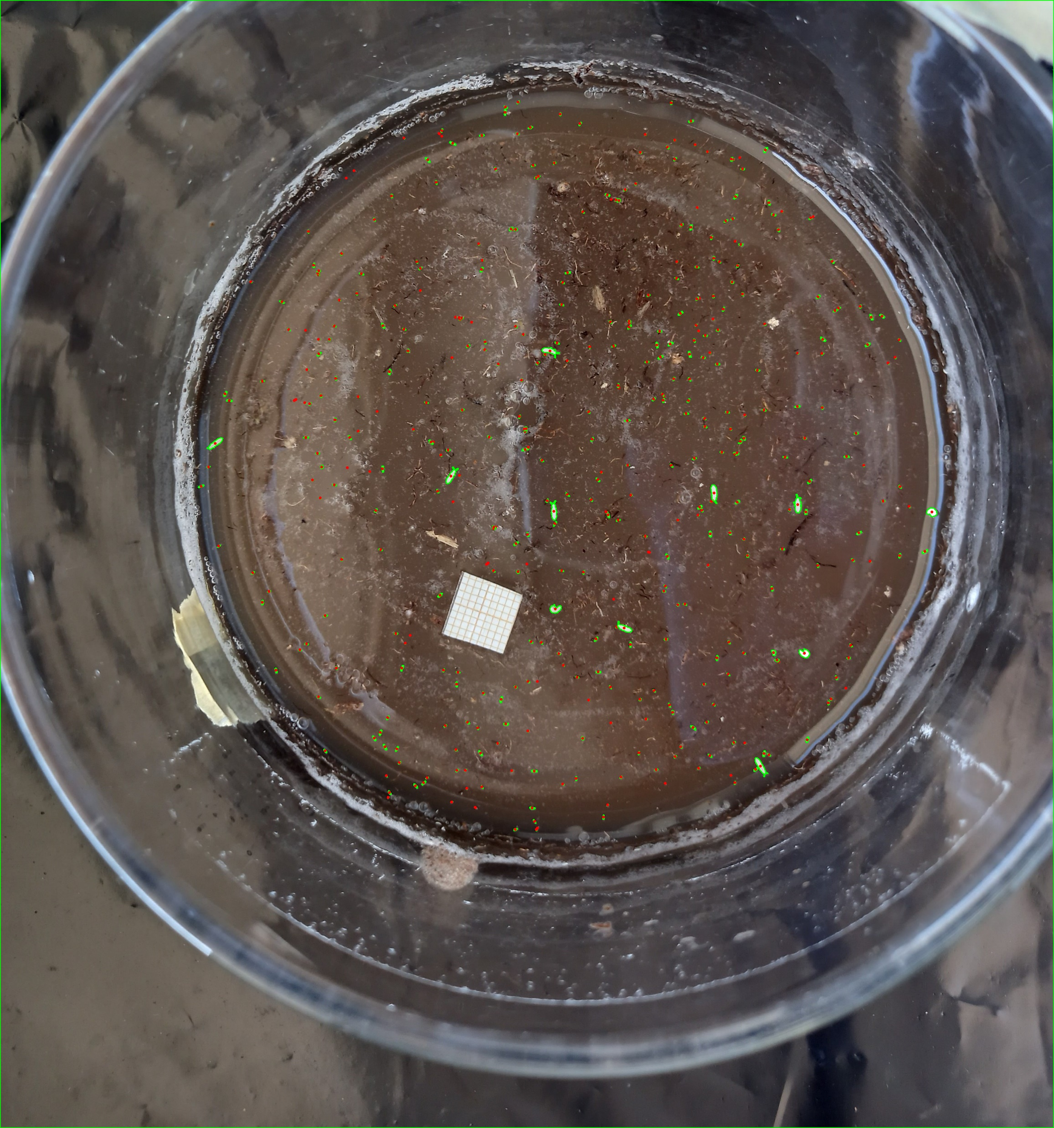

Slide 7


Automatically generated bounding boxes

Slide 9
Splitting data into training, testing, validation

Slide 10
Splitting data into training, testing, validation
Original
Sliced

Slide 11
Inference
Original
Sliced
SAHI 640

Slide 12
Results

Slide 13
Human error

